Slide 1

Waste Management
#2
12th December 2024
Chris Paterson, Senior Nurse, IPC
Notes:
Hello and welcome to this Back-to-Basics seminar presentation brought to you by ARHAI Scotland.
This is the second in a series of seminars looking at key issues that have been highlighted to us by our stakeholders. In this presentation we will be looking at Waste Management.

Slide 2
Learning outcomes
  How to access the CHIPCM site
  Understand where to locate the information
  How to manage and store waste safely and effectively
  Understand the importance of safe sharps management
Notes:
We hope that by the end of this session you will know how to access the CHIPCM site, where to locate the relevant information, how to manage and store waste safely and effectively and understand the importance of safe sharps management

Slide 3

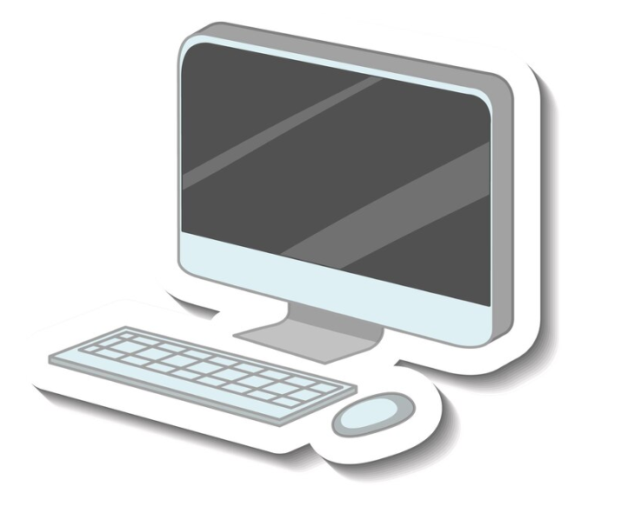
Modern technology
Enter a recognised search engine e.g. Google and type Care Home Infection Prevention and Control Manual
It will be displayed very close to the top of the page – also available at www.nipcm.scot.nhs.uk>care-home
Notes:
In modern times technology has exponentially advanced where we can access pretty much anything, anywhere, any time at the touch of a button. I must apologise, if you are extremely familiar with this process and regularly access the CHIPCM content, however as a refresher for those that may not use it that frequently, please access your mobile phone.
Open up a recognised search engine - I always tend to use google – however there are other search engines available. Start to type in Care Home Infection – you will get to the F and it is displayed close to the top. This might slightly differ depending upon the search engine used.
Click on the result Care Home Infection Prevention and Control. It has CHIPCM in brackets next to this. CHIPCM will now be used throughout the presentation to refer to the Care Home Infection Prevention and Control Manual
The CHIPCM is also available the old-fashioned way at by typing www.nipcm.scot.nhs.uk into the search bar.

Slide 4
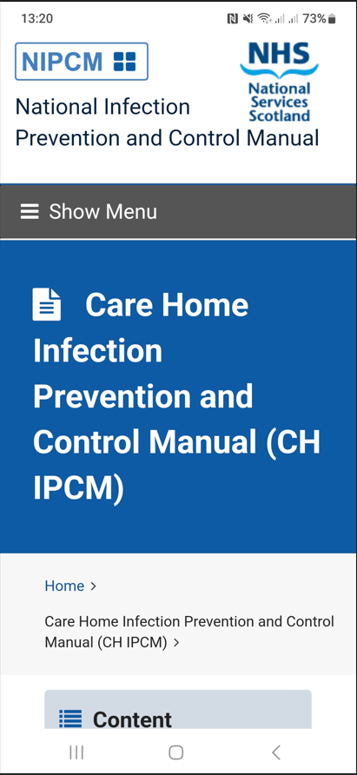
From your phone
Click on Show Menu
Gives you access to index and menu
Click on Hide Menu
Scroll down
Content (SICPs / TBPs)
Appendices
Resources
Contact us
Notes:
Once accessed on your mobile, It will look something like this.
On the top bar there is a drop down that says Show Menu – You will be able to access the index and menu by clicking on this tab. It can also be minimised by clicking on the same tab which will change to Hide Menu. All the main components of the CHIPCM are available by scrolling down to the relevant Standard Infection Control Precaution (which will be referred to as SICPs) /Transmission Based Precaution (which will be referred to as TBPs) /appendices/resource/contact us sections.
You can click on any of the hyperlinks within the content relevant to your interest and this will automatically take you to the specified section.
In the content section as we are looking at Waste Management – this is Standard Infection Control Precaution or SICP no 9 - which is Safe disposal of waste (including sharps) and SICP 10 which is Occupational safety: Prevention and Exposure management (including sharps).
This is how you access any of the content of the CHIPCM which can be done – any time - any place as long as have access to a mobile device.

Slide 5
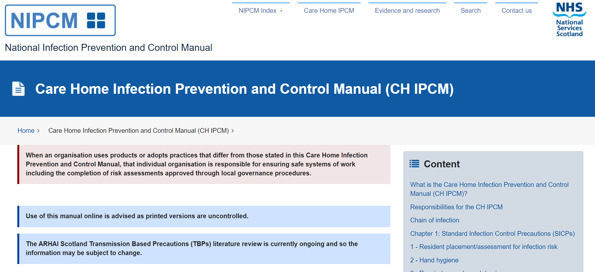
From a PC / laptop
Notes:
If you are using a PC / Laptop - It will look a little different - It must be emphasised that the same principles as that of your mobile phone will apply.
With your PC / Laptop – instead of Show Menu – you click on the NIPCM index – (highlighted within yellow oval circle). Again, by clicking on this drop down and scrolling down and selecting the relevant link, it will take you to the desired section. There are other tabs along the top of the screen that can be activated by clicking on them and then clicking on the relevant subject. On the content list on the right of the screen – you can click on any of the sections which are hyperlinked to the chosen section.
It must be noted and advised that printed copies of any components of the CHIPCM, resources or appendices are uncontrolled when printed and may not contain the most up to date information if used at a later time. Therefore, printed copies should only be used at the time of printing and electronic versions always consulted for the most recent versions and information.
You can get lots of advice and information from the CHIPCM, but if local advice is required, contact your local Health Protection Team or The Infection Prevention and Control Team that covers your Board.
Remember the CHIPCM is based on scientific literature and is considered best practice. Therefore, It must be highlighted that if an organisation uses products or adopts practices that differ from those stated in the CHIPCM, that individual organisation is responsible for ensuring safe systems of work including the completion of risk assessments approved through local governance procedures.

Slide 6
Standard Infection Control Precautions (SICPs)
SICPs are used to reduce the risk of transmission of infectious agents from known and unknown sources of infection.
These should be used by all staff, in all care settings, at all times, for all residents whether infection is known to be present or not to ensure the safety of residents, staff and visitors in the care home.
SICPs should be part of everyday practice and applied consistently by everyone in the care home.
Notes:
So, Waste Management – What is it all about – Waste management is a core component of SICPs which are used to reduce the risk of transmission of infectious agents from known and unknown sources of infection.
SICPs should be used by all staff, in all care settings, at all times, for all residents whether infection is known to be present or not to ensure the safety of residents, staff and visitors in the care home.
SICPs should be part of everyday practice and applied consistently by everyone in the care home.

Slide 7
What is waste?
In the most basic of terms, “Waste” can simply be defined as items discarded once used or unsuitable for use.
Notes:
What is waste - In the most basic of terms, “Waste” can simply be defined as items discarded once used or unsuitable for use.

Slide 8
What is Waste?
Within care homes we will produce some kind of waste during our working day. This could include an empty plastic bottle, food waste or a syringe used to administer medication.
The key thing to remember if you produce or handle any waste is that it is your responsibility to ensure it is handled or managed correctly to:
Reduce the likelihood and consequences of any harm to others and the environment arising from the waste
Comply with all applicable legislation, guidance and good practice
Notes:
Within care homes we produce various kinds of waste during our working day. This could include paper towels, flowers, empty plastic bottles, food waste or even a syringe and needle used to administer medication.
The key thing to remember if you produce or handle any waste, is that it is your responsibility to ensure it is managed and handled correctly in order to:
Reduce the likelihood and consequences of any harm to others and the environment arising from the waste
Comply with all applicable legislation, guidance and good practice

Slide 9
Safe disposal of waste (including sharps - SICPs 9 & 10)
Literature review completed March 2025
Categorisation determined by legislation
Detailed and interpreted in SHTN 03-01
Clinical assessment prior to disposal
Different waste streams
Notes:
Safe disposal of waste (including sharps - SICPs 9 & 10)
The safe disposal of waste literature review is due for completion by the end of March 2025 which will provide guidance and is based on the most up to date available evidence
Categorisation of waste is governed by legislation and is not covered within this presentation. However, further information regarding this can be found within Scottish Health Technical Note (SHTN) 03-01.
It must always be promoted that waste undergoes clinical assessment for risk of infection prior to disposal and that waste is segregated safely and timeously into the correct waste streams.
Some care homes may have specialist contracts in place and therefore the waste streams may differ slightly. Always seek guidance from your local contractors. Again, it is the responsibility of care homes to ensure they have processes in place to manage, process and safely store any waste generated until uplift has been completed.

Slide 10
Safe management of waste
Segregated accordingly - colour coded waste streams
Receptacle locations
Functioning
Appropriate storage
Schedules
SHFN 01-05 Cleaning Specification for Care Homes (SHFN 01-05) V2
Notes:
Safe management of waste
Segregation - Care homes will generate a significant amount waste. Therefore, care should be taken to ensure that waste generated is assessed and segregated accordingly as per local arrangements and that the appropriate colour coding systems are in use. Colour coding systems should be inclusive of waste bags and waste bins. If waste has been segregated into the incorrect waste stream at the time of disposal – this waste should not be rehandled and should be disposed of via the most hazardous classification within it.
Receptacle Locations - The location of waste bins is crucial for the safety of all involved. Waste bins must be risk assessed as to their location and should remain under continuous review as there are circumstances which may lead to the need for bin locations to be reassessed. Bins should not restrict corridors or fire access paths. It must also be assessed as to whether they are within the confines of the residents room/residents bathrooms. This could be influenced by many factors including self-harm risks (for instance suffocation), small children who are visitors accessing the bins, or residents who are in a confused state. Other factors to consider may include space, temperature and any other local risks identified.
Functioning - Bins must be functioning. They must be in a good state of repair with foot pedals which are working. Pedal bins which are functioning properly negate the need for lifting bin lids with hands as contact with the bin lids could lead to unnecessary cross transmission of potentially harmful pathogens. Broken and cracked bins do not provide optimal waste facilities and could constitute an environmental contamination risk from potential leakage – if spillage leaks from waste sacks within. They also do not facilitate ease of cleaning and should therefore be replaced if they are not intact or functioning properly.
For Storage of waste - Waste must be stored in appropriate areas which is not accessible to residents or the general public. Waste awaiting uplift should be in a locked safe designated area. It must also be ensured that waste bins are never overflowing including the large waste storage bins spilling out into surrounding areas which could cause environmental contamination.
Schedules - Schedules should be in place for the regular emptying of waste bins. It is possible that waste generated may contain potentially harmful pathogens which can infect other residents, staff and visitors and therefore bins should never be overfilled or overflowing spilling out into surrounding areas. The schedules should also be inclusive of cleaning for the bins themselves, which must be kept clean and in a good state of repair. This includes the internal and external components of the bin. Internal contamination of the bins will lead to significant external contamination of the bags which are placed within – causing a potential means of cross transmission of potentially harmful pathogens. Waste bins should be regularly cleaned with a general-purpose detergent. If bins are contaminated with bodily fluids (not containing blood), then excess fluid should be absorbed by using disposable roll and then decontaminating with 1000ppm available chlorine. If the fluid is or does contain blood, then the same principles would apply. However, a solution containing a higher concentration of chlorine at 10,000ppm is required. It must be promoted that manufacturer instructions for bin cleaning and preparation of solutions and contact times are always followed and adhered to. Some areas may have spill kits that could be used and again if applicable, manufacturer's instructions should always be followed. It must always be promoted that appropriate Personal Protective Equipment (PPE) is worn when decontaminating fluid spillages within the base of or decontamination of waste receptacles.
A point to note is that when bins are being cleaned – care must be taken to ensure they are properly dried at the end of the cleaning process.
The Cleaning Specification for Care Homes (Scottish Health Facilities Note – which is SHFN 01-05) should be utilised and incorporated into processes within your care home. The content of the cleaning specification can be accessed by following the link or simply by typing “national cleaning specification for care homes” into your search engine.

Slide 11
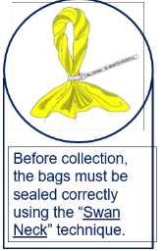
Staff responsibilities
Overfilled
PPE
Point of generation
Swan neck technique
Regular hand hygiene
UN approved receptacles
Notes:
Overfilled waste bags- Waste bags should be changed regularly. Staff must be mindful of this and never think that emptying a bin is not their job – this is especially true when bins need changing. Waste bins should be no more than ¾ full at time of emptying. Overfilled bins constitutes an unnecessary environmental contamination risk and a risk to the residents, staff and visitors. It may also lead to the requirement for additional cleaning and decontamination of the area involved.
PPE - PPE should be appropriate to the task and donned at the correct point in the process which should always be as close to its intended use as possible. It should also be removed immediately after its intended purpose with hand hygiene completed immediately after the doffing of PPE. It must be emphasised that PPE (gloves) is not a substitute for hand hygiene and the same principles apply with regards to hand hygiene whether gloves are being worn or not. If PPE is not removed at the correct time following the completed task with hand hygiene carried out, this potentially leads to the cross transmission of pathogens from the waste streams which were being processed.
Area of generation - Waste should not be carried unless within a suitable bag for doing so. In other words, do not carry used incontinence aids or blood-stained swabs down a corridor. Waste should be disposed of as close to the point of generation as possible. If risk assessed that the bin is some distance away, please ensure you are taking a waste disposal bag to the point where waste is generated. Once placed in the waste bag at the point of care, transport to its safe waste disposal location.
Swan neck technique - Once bags are ¾ full and ready for changing, a swan neck technique should be used to seal the bag. Swan neck involves rotating the bag whilst holding the top. This can then be double over and secured with cable ties or tape creating a handle which will assist with the transportation of the waste bag. It is also the most effective way to minimise the risk of any waste spillage from the bags. Waste bags should not be utilised to dispose of free fluids.
Regular hand hygiene - After any contact with waste streams – hand hygiene should always be performed as per the WHO 4 moments for hand hygiene (this could be moment 3 – which is after body fluid exposure risk).
Un approved receptacles - All waste receptacles should conform to the correct UN approved standards and as previously stated be clean and in a good state of repair.

Slide 12
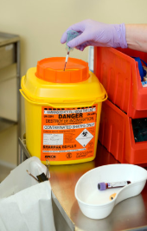
Sharps and sharps safety
All care homes should have policies in place to ensure that staff are protected from occupational exposure to microorganisms (germs), particularly those that may be found in blood and body fluids.
A sharp is a device or instrument such as needles, lancets and scalpels which are necessary for the exercise of specific healthcare activities and are able to cut, prick and/or have the potential to cause injury.
Notes:
Sharps and sharps safety - All care homes should have policies in place to ensure that staff are protected from occupational exposure to microorganisms (germs), particularly those that may be found in blood and body fluids.
When we refer to a sharp - A sharp is a device or instrument such as needles, lancets or a scalpel which are necessary for completion of specific healthcare activities and are able to cut, prick penetrate or pierce and have the potential to cause injury and is governed by legislation.
If an occupational exposure incident should occur – please follow Appendix 10 of the CHIPCM – with the completion of first aid followed by reporting and documentation of the incident as per local procedures.

Slide 13
Safe sharps management
Sharps handling must be assessed, kept to a minimum and eliminated if possible. Approved safety devices should be in use.
Notes:
Sharps handling must be assessed, kept to a minimum and eliminated if possible with the use of approved safety devices.
Safer sharps devices are designed to incorporate a safety feature or some form of mechanism which helps to minimise and or prevent the risks of an accidental needlestick injury.

Slide 14
Safe sharps management
Appropriate PPE
Hand hygiene
Single unit
Re-sheathing
Transporting
Sharps containers
Safe location
Temporary locking
Notes:
Appropriate PPE - Sharps management could constitute a risk of exposure to blood and or bodily fluids. Therefore, where risk assessed as the case, the appropriate PPE should be donned immediately before the task and doffed immediately upon completion.
Hand hygiene is an essential element of care and should be completed prior to the task which would be as per moment 1 (before touching a resident) or moment 2 if administering an injection (which is before clean / aseptic procedure). And likewise, again as per moment 4 (after touching a resident) after completion of the task and removal of the PPE – all of which are as per the 4 moments of hand hygiene.
Always dispose of needles and syringes as a single unit. Never try and separate the needle from syringe – dispose of as one. Care must be taken during disposal. Never try to throw or drop from a height the sharp into the sharps receptacle. Carefully place the sharp into the sharp's receptacle taking care not to put hands or fingers inside the opening. Sharps must never be shoved or forced into sharps bins to reduce the risk of needlestick injury.
Never try and re-sheath needles to reduce the risk of needlestick injury. If the needle is used to prepare a medicine for injection, disposal of the needle at the point of generation.
For transportation - If you are ever transporting sharps, it must be ensured they are being transported safety on an approved receptacle which is intended for this purpose only – like a sharp safe tray. Never carry them by hand and never put them in your pocket. If taking a sharp system to a resident, this should be inclusive of a means of disposal at the point of care and the sharp should be put into the sharps receptacle immediately upon completion of the intended task. Never leave used sharps lying on a bed side table or furniture and never leave on bed clothing next to residents as they can easily become entangled or lost in bed clothing which could lead to the potential of a needlestick injury to yourself, other staff and visitors.
Sharps containers - must be UN approved and in line with legislation. The size of the container will be based on risk assessment regarding the sharps generated within your area. Colour coding of sharps containers will be in use. Their lids are usually the means of identifying categories of sharps generated. Mostly orange or yellow lidded sharps bins will be in use, however manufacturer instructions on categorisation of sharps must always be followed – which again is governed by legislation. It must be ensured that sharps containers are assembled correctly, with all components between the lid and the base properly clicked into place. Ensure the label on the sharps bin is filled in at time of assembly with details including date, area and the person who has assembled the container. Also observe the external surfaces of the sharps bin and keep them clean. Sharps containers should not be filled more than ¾ full (or to the manufacturer fill line). When the receptacle is deemed full, the closure mechanism should be fully activated and the remaining components on the label completed which usually includes date and the person sealing the receptacle. Used sharps containers, the same as generated waste – should be stored in a safe locked location away from residents and the general public.
Safe location - Sharps containers in use should be stored away from worktop edges to reduce the risk of them falling on the floor. They should also not ever be stored on the floor.
And finally - The temporary locking mechanism should be activated when the system is not in use. Manufacturer’s instructions should be followed for activating this feature as some bins may differ in how such safety features are activated. The use of the temporary locking mechanism will minimise the risk of spillage and promotes safe transportation of the system to the point of care where sharps will be generated.
When the task is about to be undertaken – ensure the temporary locking mechanism has been deactivated prior to commencement of the task to avoid trying to open the lid whilst holding a used sharp.

Slide 15
Learning outcomes
  How to access the CHIPCM site
  Understand where to locate the information
  How to manage and store waste safely and effectively
  Understand the importance of safe sharps management
Notes:
Let’s review the learning outcomes we set at the beginning of this presentation. There has been a lot of information here and we hope you now understand
How to access the CHIPCM site
Where to locate the information
How to manage and store waste safely and effectively
Understand the importance of safe sharps management

Slide 16
Thank you for listening nss.ARHAIinfectioncontrol@nhs.scot
Notes:
Thank you for listening to this Back to Basics presentation. If you have any queries, please don’t hesitate to contact us at this email address: nss.ARHAIinfectioncontrol@nhs.scot

